Slide 1
Grand Saline
CTE Advisory Committee Meeting
September 16, 2019

Slide 2
SSA Member Benefits
Carl Perkins CTE Grant support
Professional development
Training in the use of online College and Career Readiness resources (Texas Career Check, Texas Genuine, Texas Reality Check, Texas On Course, etc.)
Provide the opportunity to purchase equipment and/or software, such as MOS vouchers, to support programs of study that lead to Industry Based Certifications on the TEA approved list.
Provide NCCER teacher training for up to 3 teachers.
Assist LEA with implementation of NCCER student certifications.
Assist counselor with the development of the 4/6-year plans to achieve the required implementation of the Programs of Study.

Slide 3
SSA Member Benefits, cont’d.
On-site technical assistance
Provide technical assistance for Microsoft Office Specialist certification exams
Provide technical assistance and/or resources on integrating CTE and academic instruction.
Assist LEA in the establishment of individual district CTE advisory committees.
Provide CTE Program Review/Evaluation, upon request.
Provide Business and Industry information that supports program development, implementation, and evaluation
Provide support with improving student outcomes and achieving accountability targets.

Slide 4
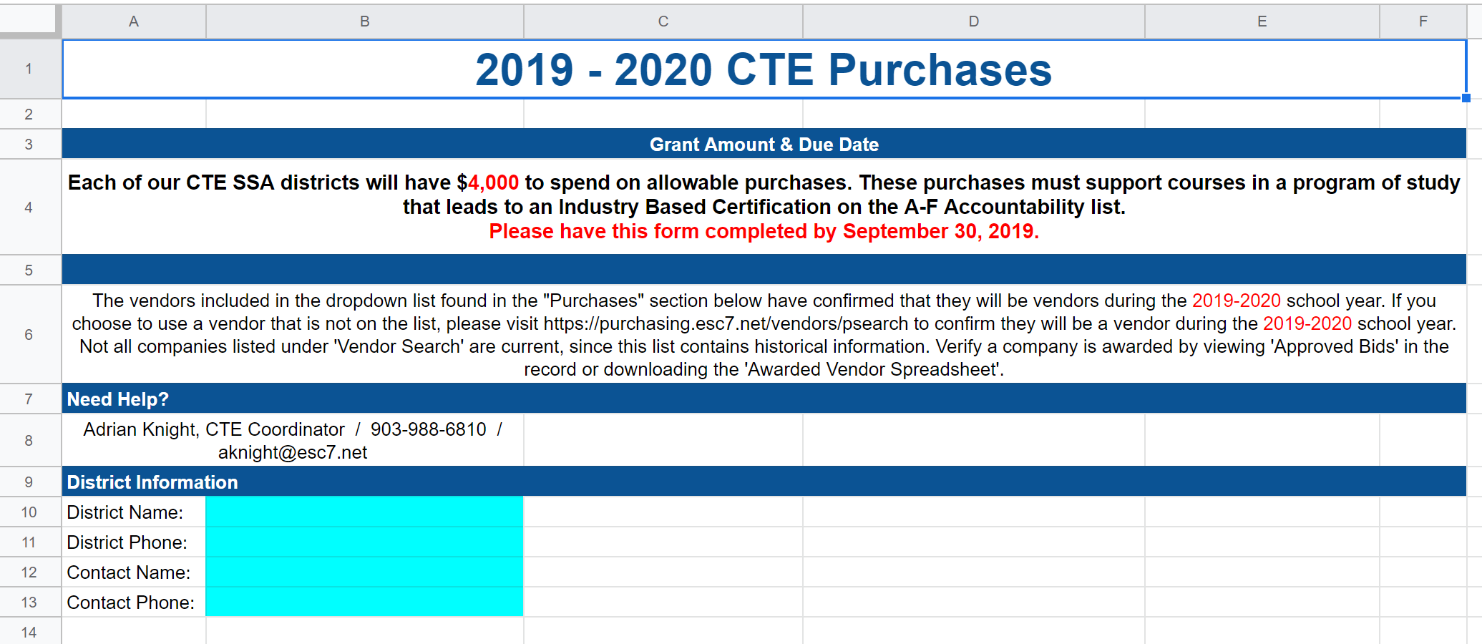
SSA Purchases

Slide 5
Examples of Allowable Expenditures
Development and acquisition of curriculum materials that include the essential knowledge and skills established by the State Board of Education (SBOE) for CTE
Purchase of new state of the art equipment or modification of equipment to meet current business and industry specifications
Professional development for academic and CTE teachers to integrate academic and career and technical skills
Supplemental accelerated instruction for students enrolled in CTE programs when such programs are designed to meet the special needs of and enhance the participation of individuals who are members of special populations
Acquisition of career interest and aptitude assessment materials and scoring costs, if applicable
Purchase of learning styles inventories and scoring costs, if applicable
Enhance and expand connections to postsecondary education, activities for career planning and guidance, integration of CTE with academics, or blocks of certifications for students only if the certifications will be reported to the state for the 2S1 technical skill attainment performance measure on the Perkins Program Effectiveness Report (PER).
Audit and upgrade CTE programs to meet industry and articulation standards

Slide 6






Slide 7
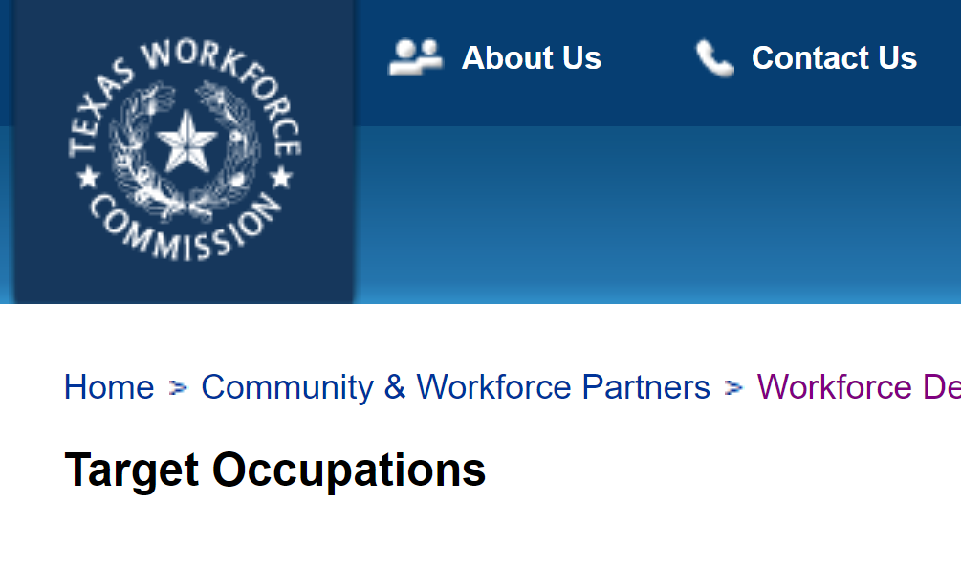
Target Occupations

Slide 8
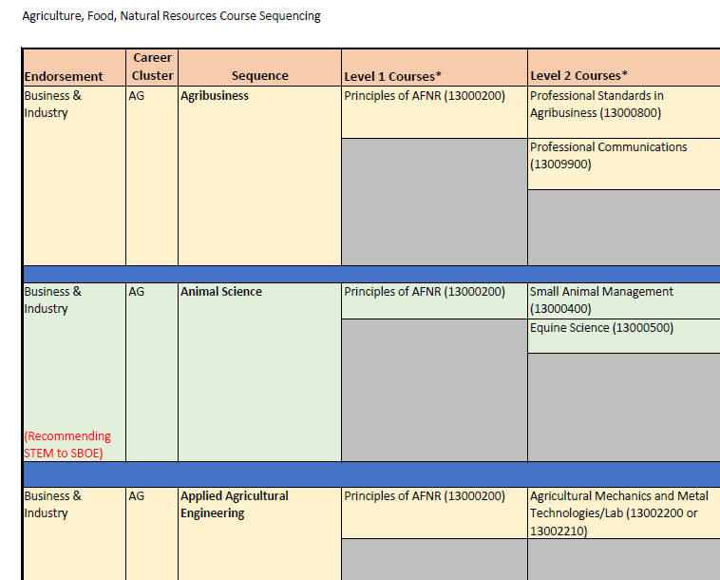
Perkins V - Programs of Study

Slide 9
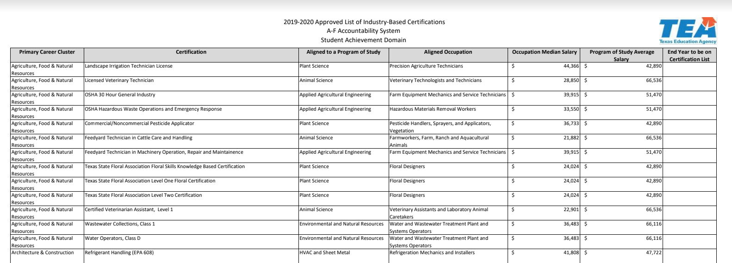
Industry-Based Certifications for Accountability

Slide 10
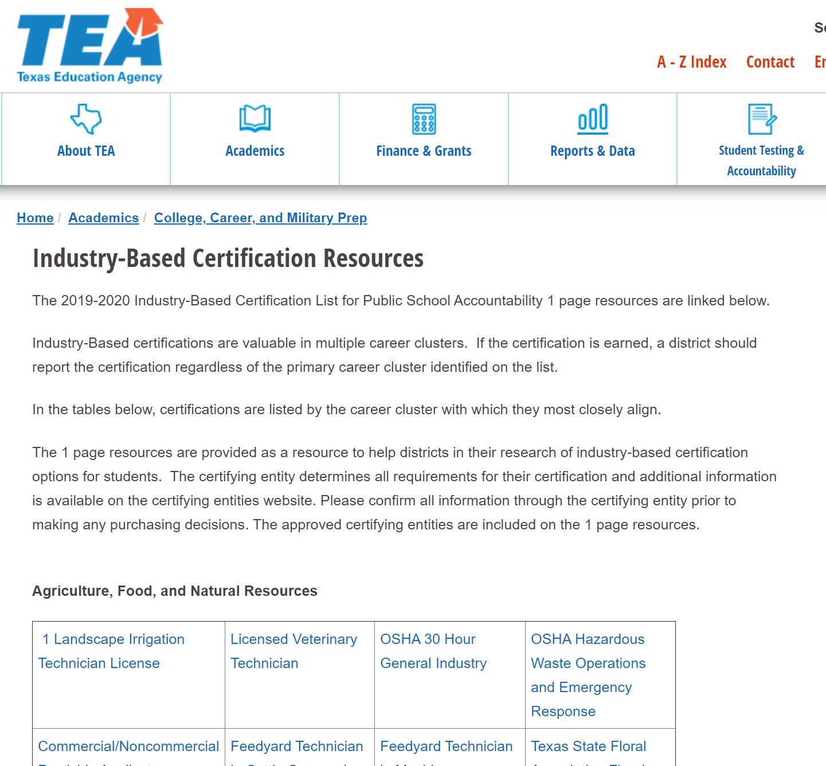
IBC One-Page Reference Documents

Slide 11
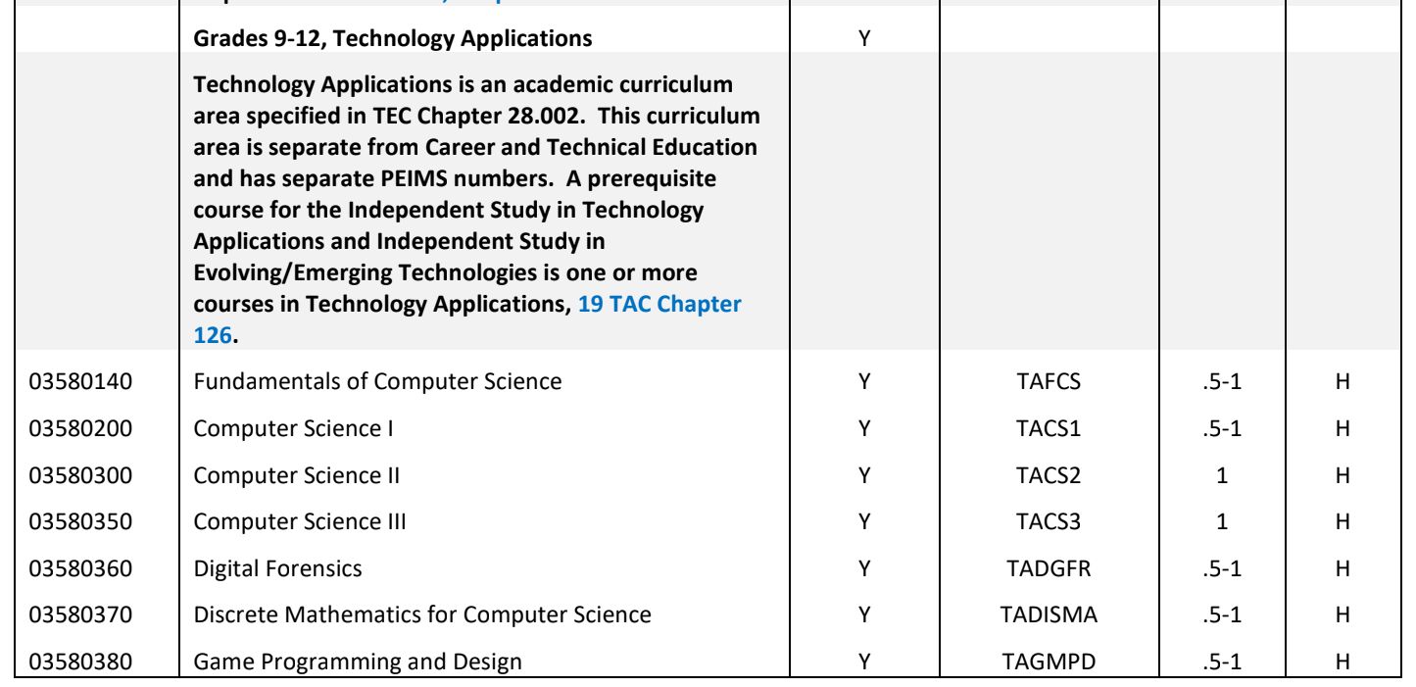
CTE Funding

Slide 12
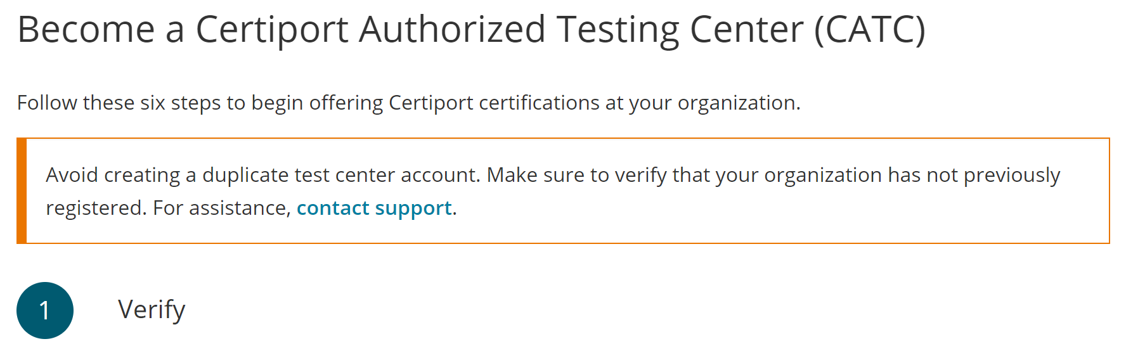
MOS Certification Exams

Slide 13
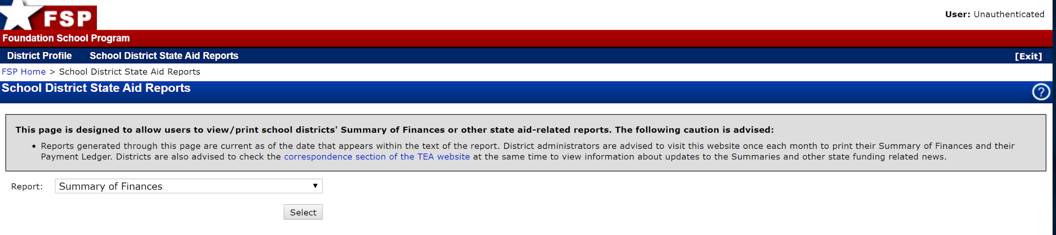
Summary of Finances

Slide 14
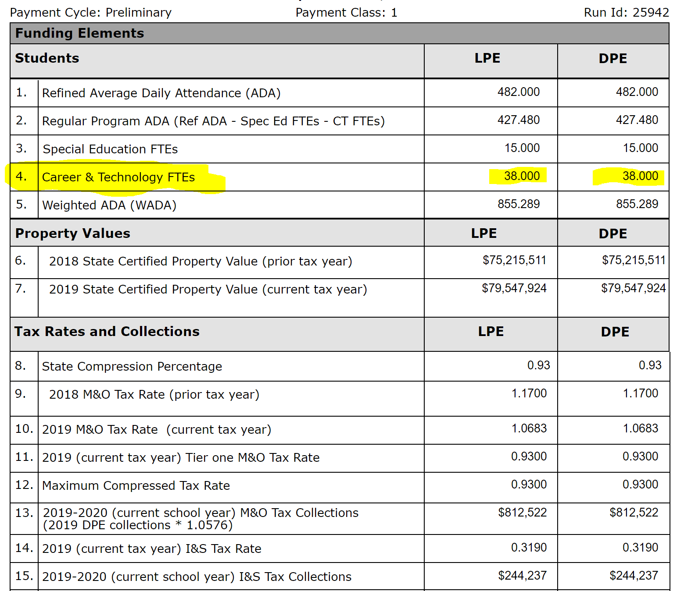

Slide 15
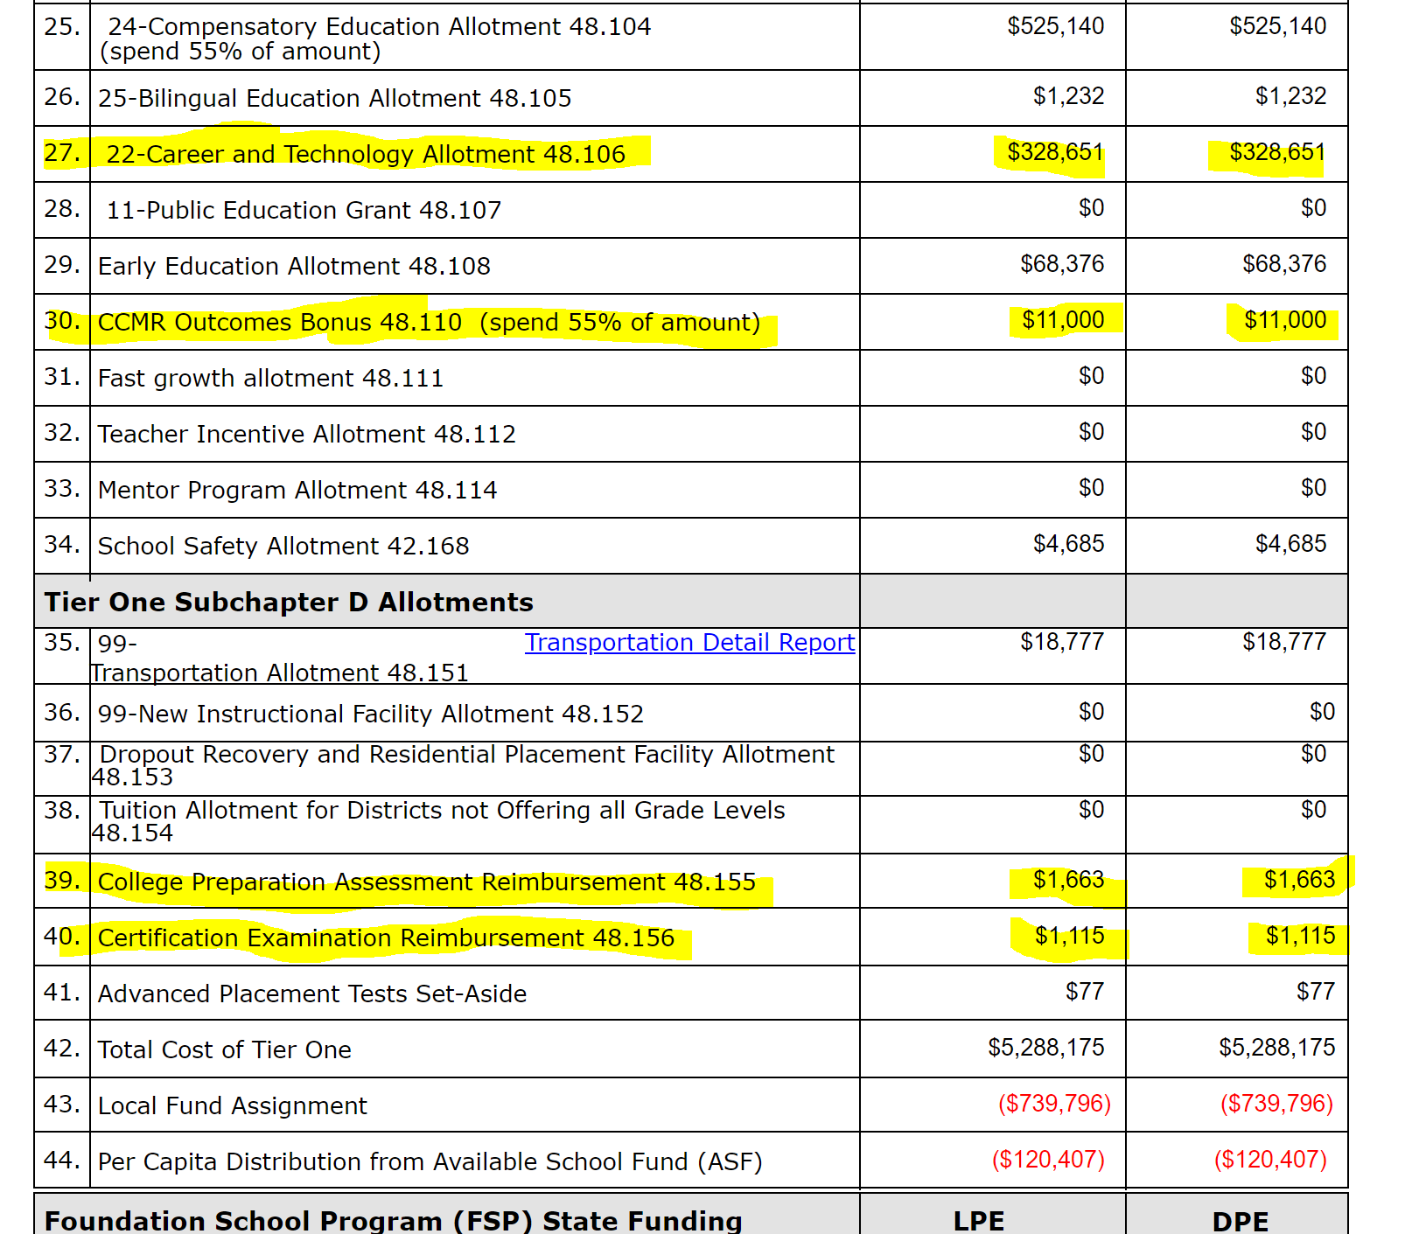

Slide 16
Upcoming Sessions
September 18 - CTAT meeting, Hallsville ISD
September 30 - CTE Program Management, Region 7 ESC
October 4 - CTE & PEIMS, Region 7 ESC
October 7-8 - NCCER Instructor Certification, Region 7 ESC
October 29 - CTE Programs of Study and Perkins V Overview - Region 7 ESC
November 14 - CCMR Leadership, Kilgore College

Slide 17
CTE Livebinders
CTE Program Management
CCMR

